Slide 1



Big Data Project - Amazon Food Reviews
Bhavana Baheti - A20115372
Chakradhar Pathi - A20096739
Mrunali Kadam - A20114076
Venkat Sai Sivakuri - A20111285

Slide 2

Outline
Introduction and Purpose of Project
Data Preparation
Model Building
Results and Assessment
Original Vision versus Final Product
Lessons Learned

Slide 3

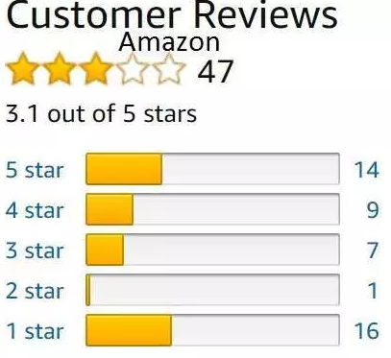
Introduction and Purpose of Project
Amazon - Biggest e-commerce giant
Driven by customer and its reviews
Capture customer feedback
Sentimental and predictive analysis
Decision making and Improvise

Slide 4


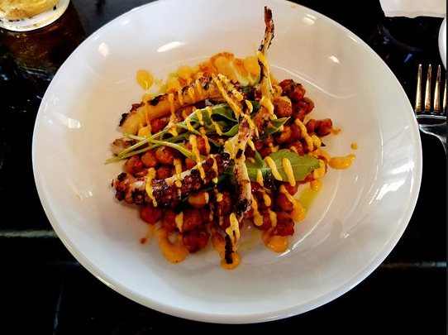

Data Preparation
1. Data Access
568,454 Total number of reviews
74,258
Total number of products
256,059
Total number of users
October 1999 to October 2012
Reviews years span

Slide 5
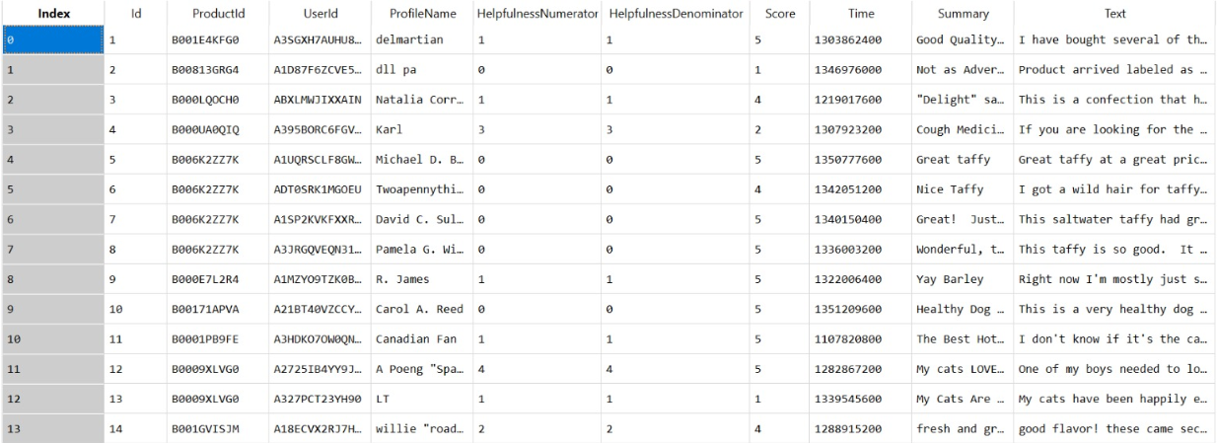
Data Preparation

Slide 6


Data Preparation
2. Data Consolidation
Single CSV file
3. Data Cleaning
Missing values
Duplicate Records
Adjustments to data types
Outliers

Slide 7
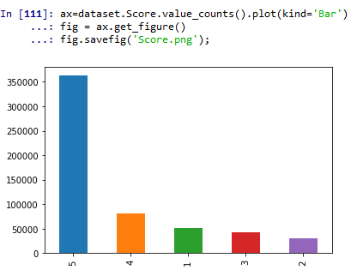
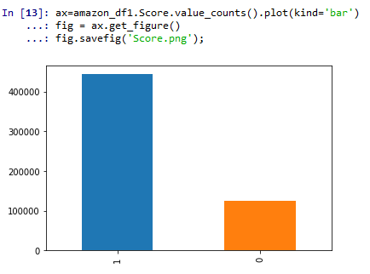
Data Preparation
4. Data Transformation
‘Score’ conversion
5. Data Reduction
‘Time’ – Unix format

Slide 8

Text Cleaning
Tokenization: Texts into words
Stemming: Obtaining the stem of a word
Removal of Stop words: Unwanted text
Strip spaces, punctuations, numbers
Creating Bag of Words model

Slide 9
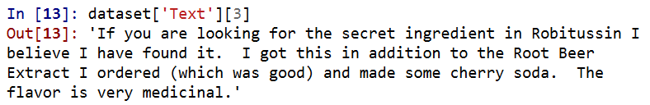


Text Cleaning
What text looks before cleaning?
What text looks after cleaning!

Slide 10
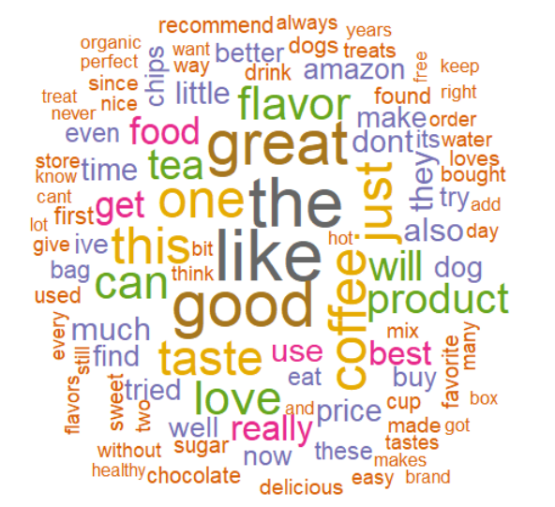
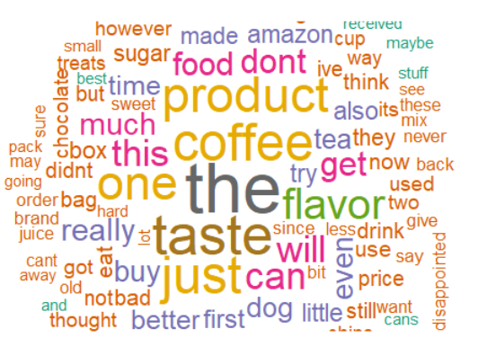
Word Cloud
Combined reviews and generated Word Cloud images
Used tm, SnowBallC, RColorBrewer packages alongside
Positive Reviews
Negative Reviews

Slide 11
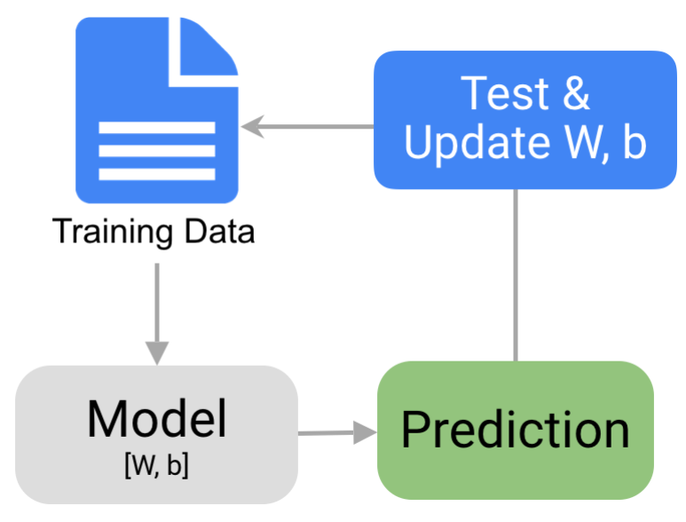
Model Building
Split the data - 454763 training and 113691 evaluation records
Choose Classifier model - Decision Trees, Random Forests
Fit the models on training set
Evaluation and Predicting Sentiment
Parameter tuning

Slide 12
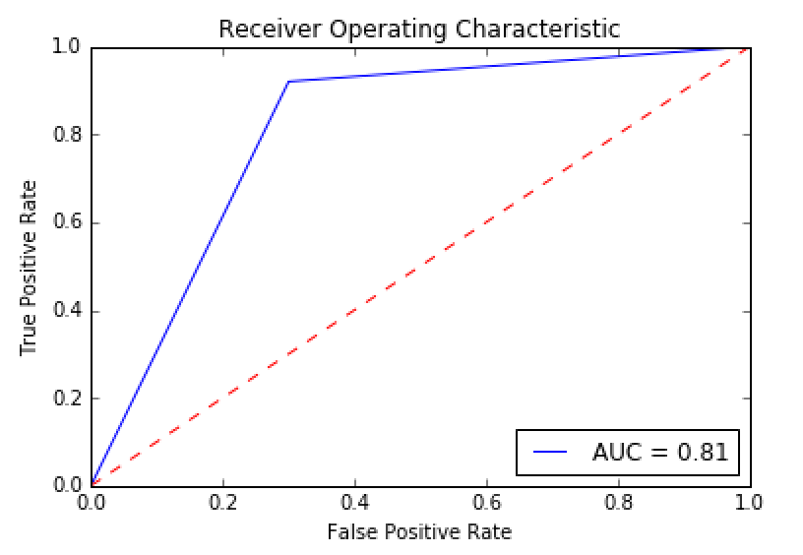
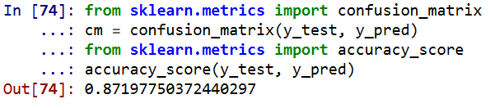
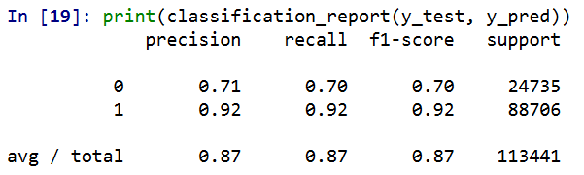
Results and Assessment
Decision Tree Performance

Slide 13
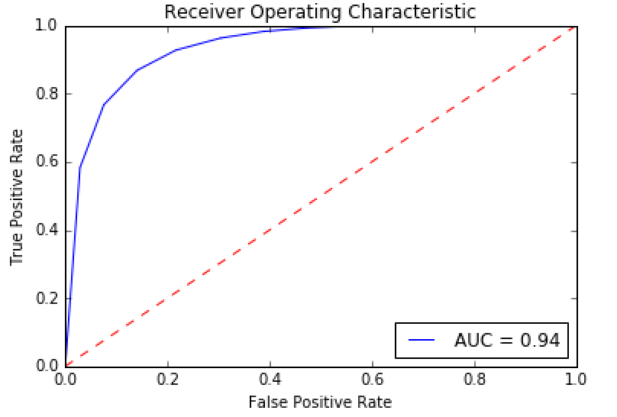
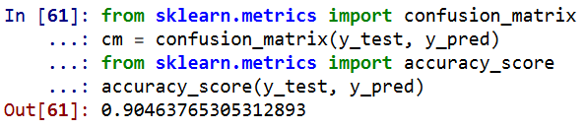
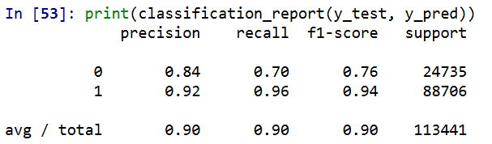
Results and Assessment
Random Forests Performance

Slide 14

Original Vision versus Final Product
Achieved our goal successfully
Understanding customer feedback
Save user’s time
Can pull run time data
Maintain customer privacy

Slide 15

Lessons Learned
Learned sentiment analysis, big data
technologies
Understand the future trends
Add value to the business
Customer behavior to the granular level
Implementation to other industries
Provide tips for writing a helpful review

Slide 16

Any Questions?

